Slide 1
Distributed Algorithms
Tutorial
Open Distributed Systems (ODS)| Distributed Algorithms

Slide 2
Agenda
Teachnet Introduction

Slide 3
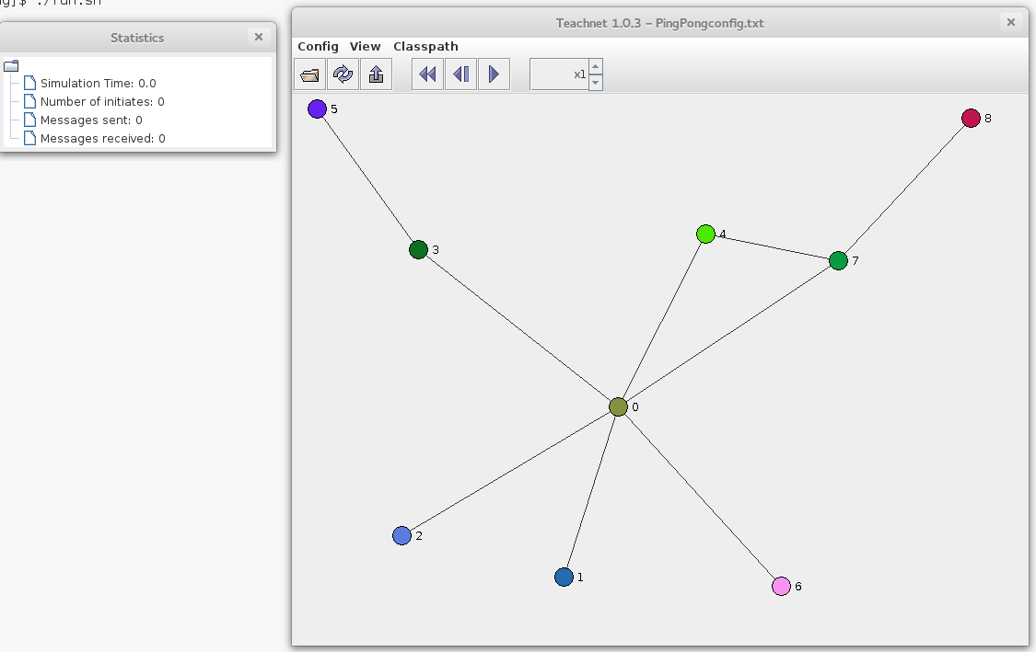
Teachnet
Event-driven simulation of distributed algorithms
Makes it easy to simulate distributed algorithms
GUI for visualization
Easy to write Algorithms
Fast configurable to different graph settings

Slide 4
Teachnet
Configurable
Create Topology
Configure Network Properties
Every Node will execute a Protocol
Initialization of node
Each node has 0-n interfaces
Every connection between nodes is a connection between particular interfaces
0
0
1
0
Node 0
Node 1
Node 2

Slide 5
Teachnet
Topology does not change during simulation
Channels are Reliable
Channels are not ordered
Channels are bidirectional
Capacity is limited by executing machine
0
0
1
0
Node 0
Node 1
Node 2

Slide 6
How to work with Teachnet
Definition of behavior of node and send messages
Write Java class which extends BasicAlgorithm
(without parameterized constructors)
Methods that must be implemented:
void initiate()
void receive(int interf, Object message)
Methods that can be overridden:
int checkInterface() gives number of interfaces
void setup(Map<String, Object> config)
void send(int if, Object msg) only way in the simulation model used to communicate with other nodes
void setTimeout(double time, Object msg) calls timeout(msg) after time

Slide 7
Demo

Slide 8
How to work with Teachnet
Please read the documentations in the “/doc“ directory and look at the example in “/templates“ directory
Recommended Order:
readme.txt or readme_en.txt
config-example.txt
guidelines.txt --- submission guidelines

